Slide 1
Mathematics curriculum in malaysia
By: radin muhd Imaduddin bin radin Abdul halim
Curriculum development division, moe malaysia

Slide 2
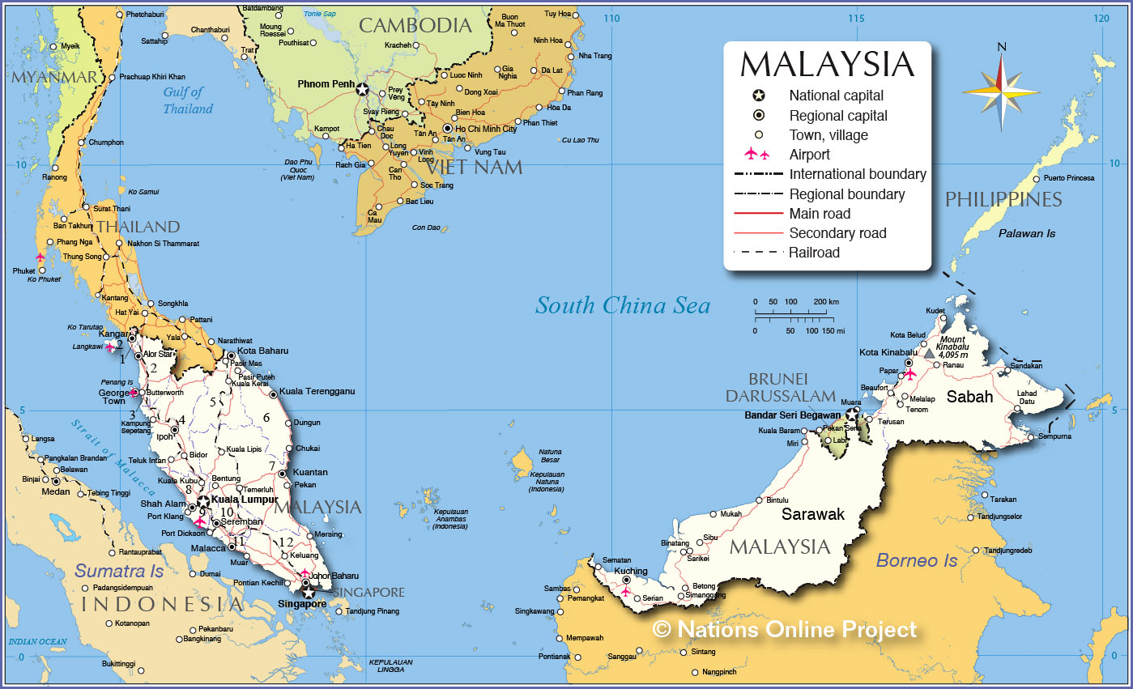

Slide 3

Curriculum development

Slide 4

Outcome based education
Standard-based education

Slide 5
Integrated Curriculum for Primay School (KBSR)
Standard Curriculum for Primary School (KSSR)
Rukun Negara
National Education Philosophy (NEP)
Malaysia Education Blueprint (PPPM)

Slide 6
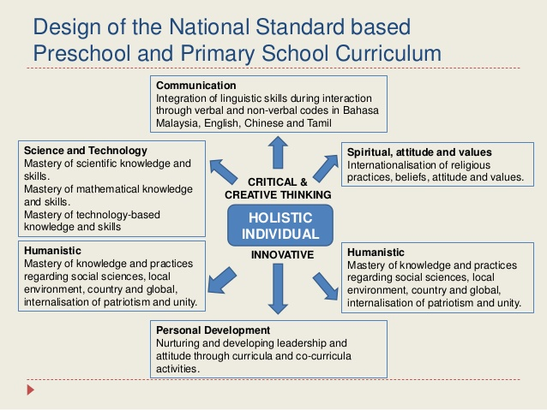
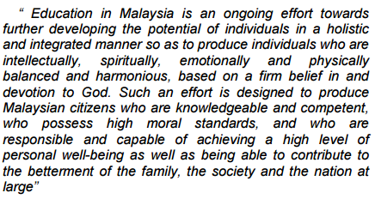
National Education Philosophy (NEP)

Slide 7



Slide 8
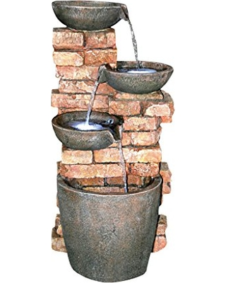
CURRICULUM DEVELOPMENT DIVISION
1
STATE EDUCATION DEPARTMENT
16
DISTRICT EDUCATION OFFICES
239
SCHOOLS
10 154

Slide 9
KBSR / KBSM | KSSR / KSSM
Communication, Man and his environment, Self-development of the individual | Communication, Spiritual, Attitude and Values, Humanitarian, Physical and Aesthetical Development, Science and Technology, Personal Appearance
Curriculum Specification which consists ‘Learning Objective’, ‘Learning Outcome’, and ‘Suggested Learning Activities’ | Curriculum Standard documents which consists ‘Content Standards’, ‘Learning Standards’, ‘Performance Standards’ and ‘Notes’
Linear Elements of analytical and creative thinking skills | Modular The elements of creativity and innovation, entrepreneurial, information technology and communication
3R’s (Reading, wRiting and aRithmetic) | 4R’s (Reading, wRiting, aRithmetic and Reasoning)
Curriculum design is based on these areas:
Curriculum Document Format:
Design of the Curriculum:
Focus:

Slide 10

Content organisation
Standard curriculum for primary school

Slide 11
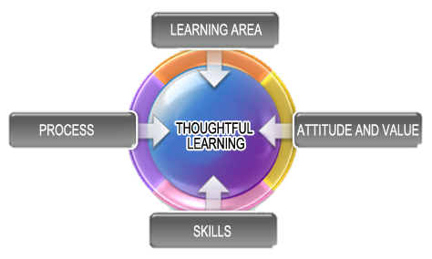
Mathematic Curriculum Frameworks
Numbers and Operations
Measurement and Geometry
Relationship and Algebra
Statistics and Probability
Discrete Number
Communication
Reasoning
Connections
Problem Solving
Representation
Perception, interest, appreciation, confidently resilient and perseverance.
Personality, interaction, procedure, intrinsic.
Thinking skills
Soft skills
Information Communication Technology skills

Slide 12
Standards Document
Text book
Assessment
Learning Modules
Teacher Training
Referrence books
Classroom
The curriculum document is the main locus for the class implementation, text book writings, and even the items to be asked in the students’ assessment

Slide 13
Topics in Primary School
Numbers and Operations | Measurements and Geometry | Relationship and Algebra | Statistics and Probability | Discrete Mathematics
Whole Numbers | Time | Coordinate | Data managements | -
Basic Operations | Measurements | Ratio and Proportions | Likelihood
Fractions, Decimals, and Percentage | Space
Money
Year 1 – Year 3 (Key Stage 1)
Year 4 – Year 6 (Key Stage 2)

Slide 14
Standard Document
Content Standards
Learning Standards
Performance Standards

Slide 15
Standard Document
…general statement about cognitive and affective domain that can be achieved by the pupils.
…specific statement of what pupils should know and able to do conceptually and practically.
…general criterion that illustrate the level of performance that the students need to demonstrate as indicator of success called Descriptor.
Knowledge
Skills
Values

Slide 16
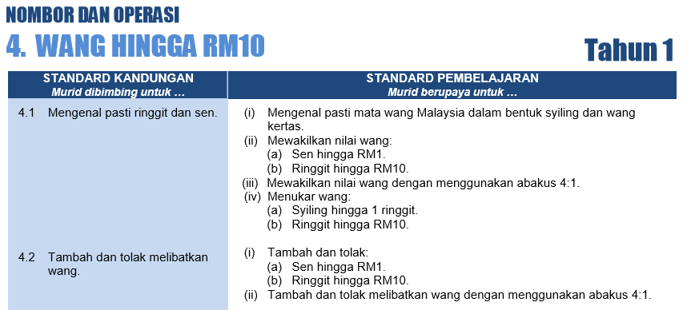
Example: KSSR edition 2011

Slide 17
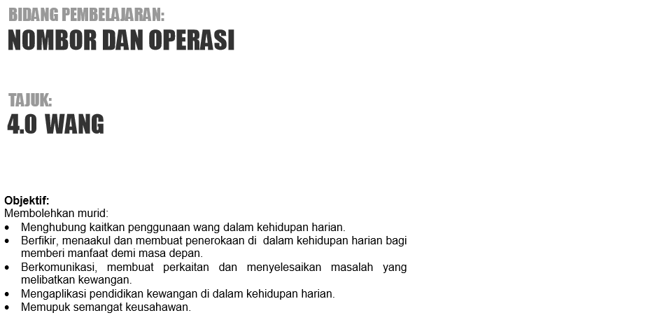
Example: KSSR edition 2017 (now in piloting phase)

Slide 18
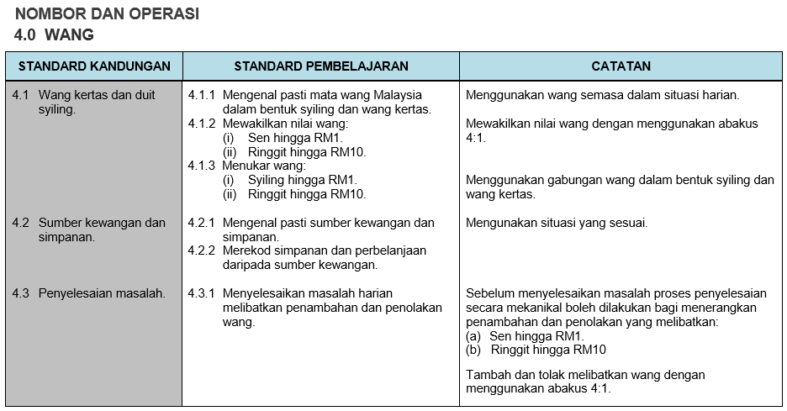
Example: KSSR edition 2017 (now in piloting phase)

Slide 19
General Descriptor for Performance Standard Framework

Slide 20
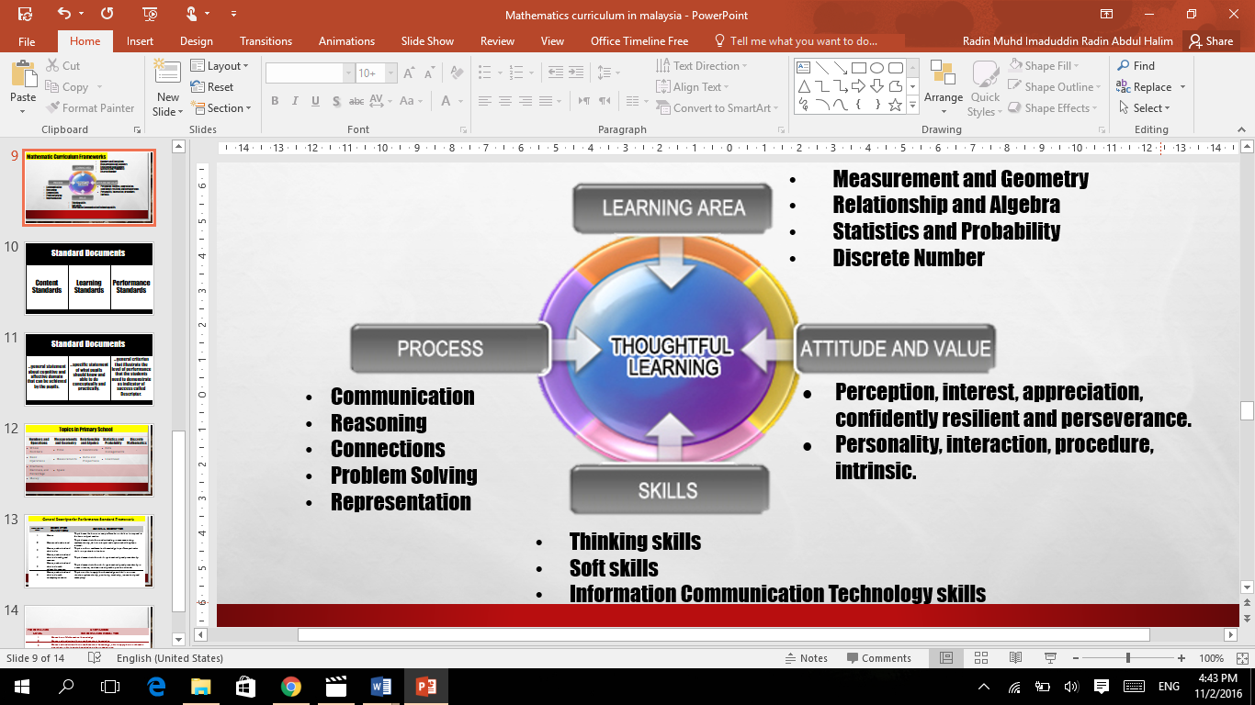

Slide 21
Able to apply mathematical knowledge and skills in solving non-routine daily problems using various strategy creatively and innovatively.
6
Able to apply mathematical knowledge and skills in solving routine daily problems using various strategy.
5
1
2
3
4
Know basic mathematical knowledge
Able to apply calculation procedures in solving routine daily problems.
Know and understand basic mathematical knowledge
Able to apply basic arithmetic operations; Able to apply knowledge on basic conversion

Slide 22
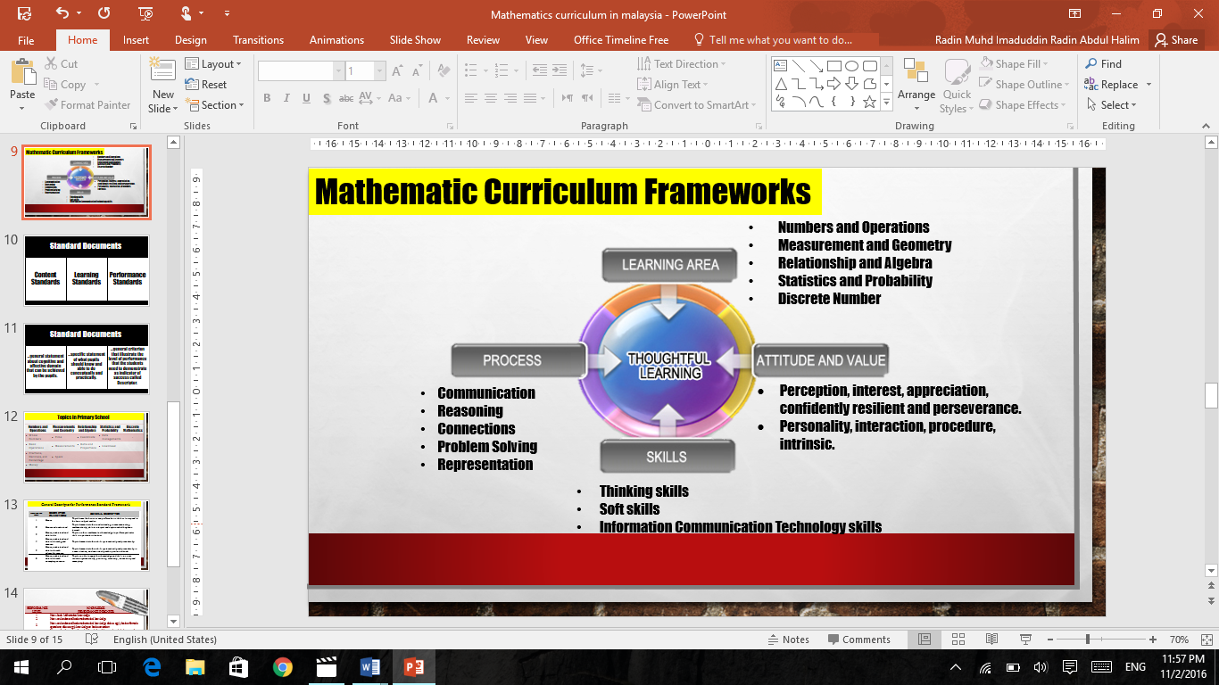

Slide 25

Issues & challenges
In curriculum reforms

Slide 26
TIMSS
PISA
KBSR
Reading
Writing
KSSR
Reading
Writing
Arithmetics
Arithmetics
Reasoning
HOTs
LOTs

Slide 27
Average Score
TIMSS 1999, 2003, 2007 dan 2011
Notes:
Purata skor matematik murid Malaysia mencatatkan penurunan yang hampir selari dengan penurunan pada peringkat antarabangsa.

Slide 28
TIMSS
High
Intermediate
Low
Below minimum
Notes:
Matematik
Peratus murid mencapai tahap tertinggi menunjukkan kemorosotan berterusan dari tahun 2003, hinggalah ke kajian TIMSS 2007 dan kekal pada 2% pada TIMSS 2011. Pencapaian pada tahap tinggi, sederhana dan rendah berbanding TIMSS 1999 menunjukkan kemorosotan peratus murid yang significant berterusan dari tahun 2003 sehinggalah pada kajian 2011.

Slide 29
Shanghai-China - 613 Singapore - 573 Hong Kong-China - 561 Chinese Taipei - 560 Korea - 554 Macao-China - 538 Japan - 536 Liechtenstein - 535 Switzerland - 531 Netherlands – 523 Estonia - 521 Finland - 519 Canada – 518 Poland - 518 Belgium - 515 Germany- 514 Viet Nam – 511 Austria - 506 Australia - 504 Ireland – 501 Slovenia – 501 Denmark – 500 | New Zealand – 500 Czech Republic – 499 France - 495 U Kingdom- 494 Iceland - 493 Latvia - 491 Luxembourg - 490 Norway - 489 Portugal - 487 Italy - 485 Spain - 484 Russian Fed. – 482 Slovak Republic – 482 United States – 481 Lithuania - 479 Sweden - 478 Hungary - 477 Croatia – 471 Israel – 466 Greece - 453 Serbia – 449 Turkey - 448 | Romania – 445 Cyprus – 440 Bulgaria – 439 UAE – 434 Kazakhstan – 432 Thailand – 427 Chile – 423 MALAYSIA - 421 Mexico – 413 Montenegro – 410 Uruguay – 409 Costa Rica – 407 Albania – 394 Brazil – 391 Argentina – 388 Tunisia – 388 Jordan - 386 Colombia – 376 Qatar – 376 Indonesia – 375 Peru – 368
OECD
Ave - 494
PISA 2012
International
Ave - 456
Notes:
Kedudukan Malaysia dalam Literasi Bacaan adalah yang ke 55 daripada 74 negara/wilayah.

Slide 30

Urban
Rural
students from high-income families do better than those from low-income families
…girls do better than boys in almost all academic subjects
…high in equality, but lack in equity of access

Slide 31
School Based Assessment
School Assessment
Physical activities, sports, and co-curricular Assessment
Psychometric Assessment
Central Assessment

Slide 32
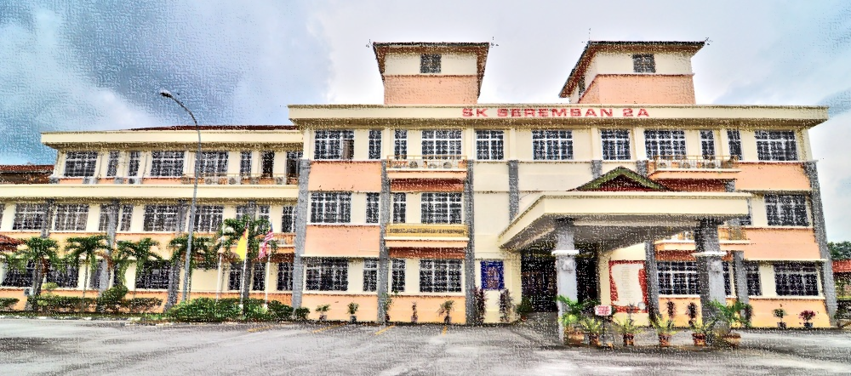
High Stake Assessment
STPM
SPM
PT3
UPSR
Y13
Y11
School-Based Assessment
to evaluate their students formatively and summatively by collecting evidence through various means such as homework, students’ presentation, project work, paper-and-pencil test, and so on.
Y8
Y6

Slide 33

SEA – BES (MATHEMATICS) :
RECOMMENDATIONS AND SUGGESTIONS

Slide 34
Rationale
…developed and used as benchmarking documents
…must be careful so that the SEA-BES document is not becoming the definite agreement
…must be comply with the traditional values in SEA countries

Slide 35
Content & Format
…don’t have to be very particular
… but should states the Content Standards and Learning Standards for every levels of schooling, in every learning areas
…for the curriculum developers or the policy makers
…can use NCTM or CCSS (US) as models

Slide 36
Processes & Activities
…can be more productive if certain processes and activities are put and stated explicitly in the standard learning
…in some conceptual understanding, students need to go certain activities and processes
…Teachers can add their creativity in implementing suitable pedagogical approach

Slide 37

…should be written to inspire or encourage the curriculum developer or policy makers in these countries to adopt and adapt
…should appear as Key-Stage-based standards, instead of grade-based standards.
21st century skills - knowhow
Regional values
Global competencies
TIMSS and PISA

Slide 38
Terima kasih
bit.ly/mathmalaysia
Radin mUhd imadUddin bin radin abdUl halim
Assistant director
Science and mathematics sector
cUrricUlUm development division
Ministry of edUcation malaysia
03-8884 2221 / 013-3668108
radin.muhd@moe.gov.my

